Slide 1
Exploring the Transition Practices of Java Back-end Frameworks: A Survey
CSE 6302: Software Quality Assurance
Final Project Presentation
Presenters: Ishita Haque (1017052031), Zarin Tasnim Promi (1017052044)

Slide 2
Presentation Overview
Background
Motivation
Related Works
Research Questions
Research Methodology
Findings and Discussion

Slide 3
Background
Since inception in 1996, Java standards, platforms, frameworks, and designs have changed as a result of usability requirement
Popular Java Frameworks over the past 10 years:
Spring Boot
Spring MVC
Struts
Hibernate
Grails
Play
Blade
Spark
Dropwizard
Quarkus

Slide 4
Motivation
Through the long time that Java has been around, developers have switched from one framework to another
Although a number of frameworks exists, no study has qualitatively explored the motivation, challenges and practises of adaptation and transition to newer frameworks from the developers’ perspectives
Exploring the adaptation and transition practises can reveal trends in Java frameworks
Exploring the adaptation and transition practises can reveal details of needs of the major stakeholder: the developers

Slide 5
Related Works
Şahin, Ahmet & Güler Bayazıt, Nilgün. (2020). What Java Developers have talked about? An empirical study on Stack Overflow. European Journal of Science and Theology. 19. 354-365. 10.31590/ejosat.702949).
Understanding the social evolution of the Java community in Stack Overflow: A 10-year study of developer interactions, Guillermo Blanco, Roi Pérez-López, Florentino Fdez-Riverola, Anália Maria Garcia Lourenço, Future Generation Computer Systems, Volume 105, 2020
P. Zhang, "What Topics Do Developers Concern? An Analysis of Java Related Posts on Stack Overflow," 2019 2nd International Conference on Artificial Intelligence and Big Data (ICAIBD), 2019, pp. 362-368, doi: 10.1109/ICAIBD.2019.8837045.

Slide 6
Research Questions
What are the motivating factor(s) behind switching from the past framework(s)?
What are the motivating factor(s) for switching to the current framework?
What are the motivating factors behind a possible plan of switching from the current framework?
What are the difference(s) perceived between past and current framework?
What are the challenge(s) faced while shifting from past to current framework?

Slide 7
Research Methodology
01
Pilot Survey
To refine preliminary survey questions
N = 2 Java developers, one mid level and one senior level
02
Survey
N = 52 participants
Open and closed ended questions
Participants: Employed and Freelancer
Google form based online survey
Interview
03
Qualitative and Quantitative Analysis
Thematic Analysis

Slide 8
Findings and Discussion

Slide 9
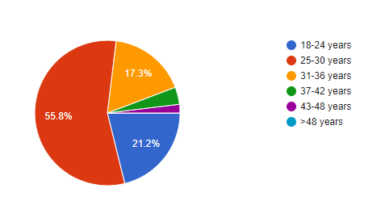
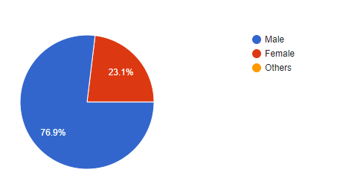
Demographic Analysis
Age Group
Gender Distribution

Slide 10
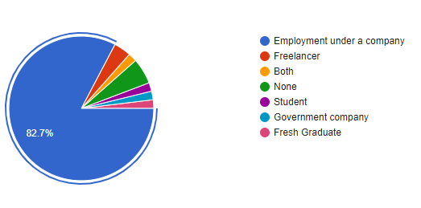
Demographic Analysis
Employment Nature

Slide 11
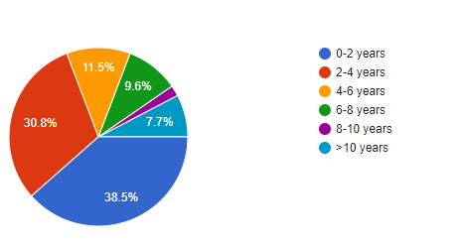
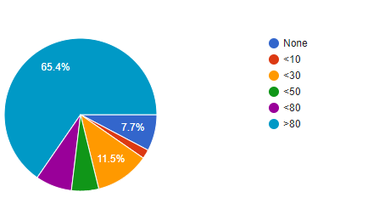
Demographic Analysis
Working Experience
No of Employee in Organization

Slide 12
Previous Work Experience with Java Frameworks
Developers previously worked mostly with
Spring Boot
Spring MVC
Hibernate
Struts

Slide 13
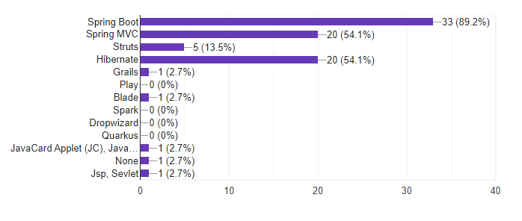
Previous Work Experience with Java Frameworks

Slide 14
Current Work Experience with Java Frameworks
Developers are currently working mostly with
Spring Boot
Spring MVC
Hibernate
Struts

Slide 15
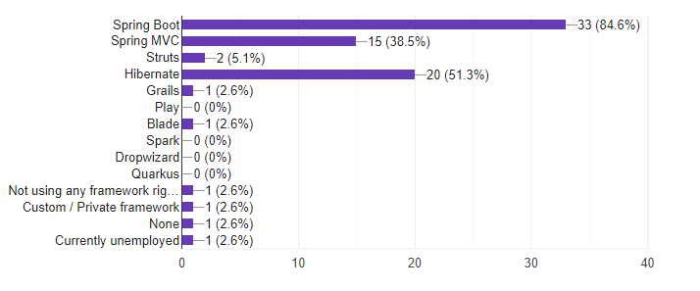
Current Work Experience with Java Frameworks

Slide 16
Factor(s) behind switching from the past framework(s)
Prominent Factors Behind Switching from the past frameworks
Difficulties in application management
Inadequate plugins and libraries
Lengthy configuration

Slide 17
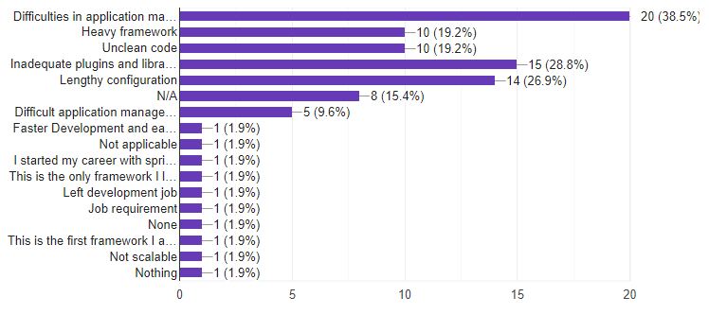
Factor(s) behind switching from the past framework(s)

Slide 18
Factor(s) behind switching to the current framework(s)
Prominent Factors Behind Switching from the past frameworks
Easy Configuration
Easy Integration
Easy Quick Development
Inversion of Control

Slide 19
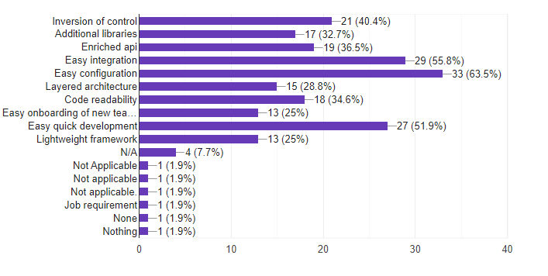
Factor(s) behind switching to the current framework(s)

Slide 20
Switching from the current framework(s)
43 participants said that they will not switch from the current framework
The factors behind this decision includes:
Easy integration
Regular upgradation of framework
Extensive plugins and library
Adequate learning resource

Slide 21
Switching from the current framework(s)
9 participants said that they plan to switch from the current framework
The factors behind this decision includes:
New better technology
Better application maintainability
Better performance

Slide 22
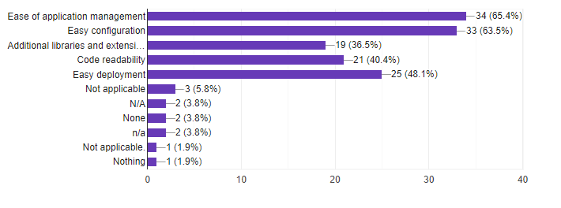
Difference(s) that were perceived between past and current framework

Slide 23
Challenge(s) faced while shifting from past to current framework
Main challenges faced while switching to current framework includes:
Lengthy learning process
Shortage of help from colleagues
Non-technical challenges

Slide 24
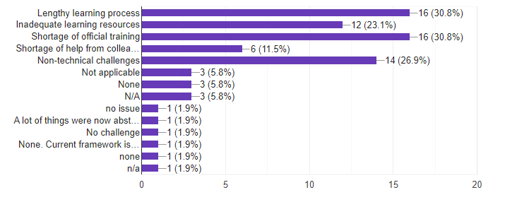
Challenge(s) faced while shifting from past to current framework

Slide 25
Thank You !
Any Questions?

